Slide 1


Hii,
Iam Siddhika
Welcome to Power BI Series
Part -48

Slide 2



We focus only on the most used and important Dax Functions
Today Content
Meet DAX
I’m soo Excited. It’s my favourite functions.
Are you ready guys?
COMMON FUNCTION CATEGORIES
7.TIME INTELLIGENCE FUNCTIONS(FEW MORE)
TOTALYTD TOTALMTD TOTALQTD
TOTALYTD Vs DATESYTD

Slide 3


TOTALYTD
TOTALYTD is used to return the year-to-date total for a given measure, summing values from the start of the year up to a specified date.
It's often used in financial and business reporting to track cumulative performance throughout the year.
Check this
Syntax
TOTALYTD(<expression>,<dates>[,<filter>][,<year_end_date>])
expression: The expression to be evaluated and aggregated.
dates: A column containing dates.
filter (optional): An expression that specifies a filter to apply to the current context.
year_end_date (optional): The date that represents the end of the year. Defaults to December 31.

Slide 4
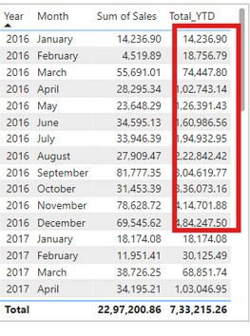

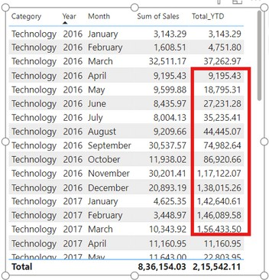
VISUAL EXAMPLE
How can you create a measure to calculate the total sales amount year-to- date using the Sales table and the OrderDate column?Using TOTALYTD
Got it?
SUM(Orders[Sales]): The expression to sum the sales amounts.
Orders[OrderDate]: The column containing the dates.
Year: The year part of the OrderDate. Month : The Month part of the OrderDate.
Sum of Sales: The sum of Sales for each year.
Total_YTD: The sum of Sales from the start of each year to the end of each year.
in this visual, you can see:
2016 jan Total YTD = 14,236,90 which is same sum of sales
2016 feb Total YTD= 18,56,79 which is sum of sales(2016 jan +2016 feb) like this it do the sum to end of the year, and for the next year it sums from the 1 jan to dec 31st
How can you create a measure to calculate the total sales amount year-to-date for the "Technology" category, considering a custom year-end date of March 31, using the Sales table and the OrderDate column?
Year: The year part of the OrderDate.
Sum of Sales: The sum of Sales for each year.
Total Sales YTD: The sum of Sales for category Technology from the start of each year and the month april 1st to the end of each year and month march 31.

Slide 5

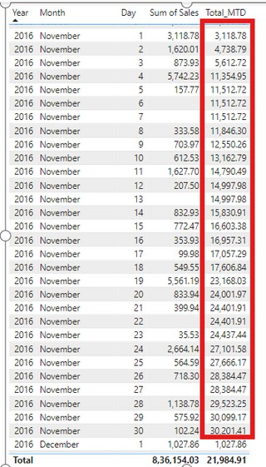

TOTALMTD
TOTALMTD is used to return the month-to-date total for a given measure, summing values from the start of the month up to a specified date.
It's often used in financial and business reporting to track cumulative performance throughout the month.
Easy?
Syntax
TOTALMTD(<expression>,<dates>[,<filter>])
Example
How can you create a measure to calculate the total sales amount Month-to-date using the Order table and the OrderDate column using TOTALMTD?
Year: The year part of the OrderDate. Month : The Month part of the OrderDate.
Sum of Sales: The sum of Sales for each year.
Total_MTD: The sum of Sales from the start of each month to the end of each month. in this visual, you can see:
2016 Nov Day 1 Total MTD =3,118,78 which is same sum of sales (2016 Nov Day 1)
2016 Nov Day 2 Total MTD= 4,738,79 which is sum of sales(2016 Nov Day 1 +2016 Nov Day 2 ) like this, it do the sum to end of the Month, and for the next Month it sums from the 1 dec to dec 31st and vice versa.
you can filter whatever you want in the dax like category =”Technology”

Slide 6
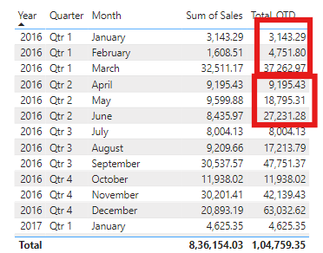
TOTALQTD
TOTALQTD is used to return the quarter-to-date total for a given measure, summing values from the start of the quarter up to a specified date.
It's often used in financial and business reporting to track cumulative performance throughout the quarter.
Understood?
Syntax
TOTALQTD(<expression>,<dates>[,<filter>])
_{Example} How can you create a measure to calculate the total sales amount Quarter- to-date using the Order table and the OrderDate column using TOTALQTD?
Year: The year part of the OrderDate. Quarter : The Quarter part of the OrderDate. Month : The Month part of the OrderDate.
Sum of Sales: The sum of Sales for each year. Total_QTD: The sum of Sales from the start of each Quarter to the end of each Quarter.
in this visual, you can see:
2016 qtr 1 jan Total QTD =3,143,29 which is same sum of sales (2016 qtr 1 jan )
2016 qtr 1 feb Total QTD = 4,751,80 which is sum of sales(2016 qtr 1 jan + 2016 qtr 1 feb ) like this, it do the sum to end of the Quarter, and for the next Quarter it sums from the april to jun and vice versa.
you can filter whatever you want in the dax like category =”Technology”

Slide 7


TOTALYTD vs DATESYTD
Both TOTALYTD and DATESYTD are used for year-to-date calculations, but they serve different purposes and have different syntax.
TOTALYTD
Calculates the year-to-date total of an expression, optionally with a filter, until the specified year-end date.
Directly calculates and returns the total YTD value in a single function call.
Has an optional filter parameter that allows you to apply a filter directly within the function.
may offer better performance for simple YTD calculations.
Example:
DATESYTD
Understood?
Returns a table of dates from the beginning of the year to the current date or the specified year-end date.
Typically used inside CALCULATE to change the filter context to a year- to-date period.
Provides flexibility to apply additional filters and perform more complex calculations.
can be more efficient for complex, multi-filter scenarios.
Example:
Similarly TOTALMTD Vs DATESMTD and TOTALQTD Vs DATESQTD have the same differences
By understanding these differences, you can choose the appropriate function based on the complexity and requirements of your DAX calculations

Slide 8


Thank you for joining me today to learn about Part -48 of Power BI!
Remember, Learning DAX is key to unlocking the full potential of Power BI for insightful reporting and visualization.
Stay tuned for more insights and tips on Power BI in our next Series.
Follow

